Slide 1




University Institute of Engineering
Department of Computer Science & Engineering
COMPUTER ORGANIZATION & ARCHITECTURE
(23CST-204/23ITT-204)
ER. SHIKHA ATWAL
E11186
ASSISTANT PROFESSOR
BE-CSE

Slide 2
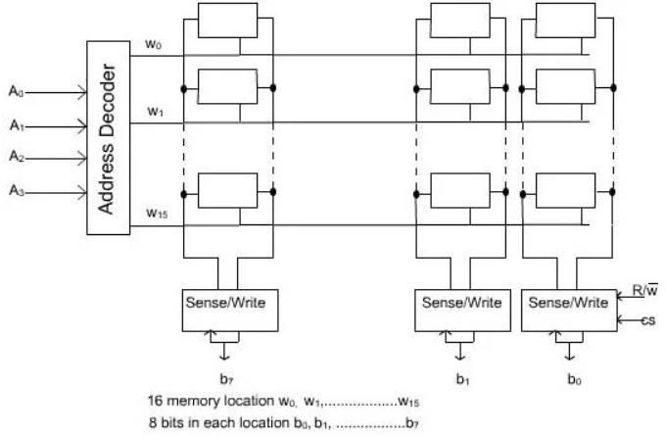
INTERNAL CHIP ORGANIZATION
A memory cell is capable of storing 1-bit of information. A number of memory cells are organized in the form of a matrix to form the memory chip.
16 X 8 Memory Organization

Slide 3
Each row of cells constitutes a memory word, and all cell of a row are connected to a common line which is referred as word line.
An address decoder is used to drive the word line. At a particular instant, one word line is enabled depending on the address present in the address bus.
The cells in each column are connected by two lines. These are known as bit lines. These bit lines are connected to data input line and data output line through a Sense/Write circuit.
During a Read operation, the Sense/Write circuit sense, or read the information stored in the cells selected by a word line and transmit this information to the output data line.
During a write operation, the sense/write circuit receive information and store it in the cells of the selected word.

Slide 4
A memory chip consisting of 16 words of 8 bits each, usually referred to as 16 x 8 organization. The data input and data output line of each Sense/Write circuit are connected to a single bidirectional data line in order to reduce the pin required.
For 16 words, we need an address bus of size 4. In addition to address and data lines, two control lines, and CS, are provided. The line is to used to specify the required operation about read or write. The CS (Chip Select) line is required to select a given chip in a multi-chip memory system.

Slide 5
Organization of 1M x 1 memory chip: The organization of 1024 x 1 memory chips, has 1024 memory words of size 1 bit only. The size of data bus is 1 bit and the size of address bus is 10 bits (as 1024=2^10). A particular memory location is identified by the contents of memory address bus. A decoder is used to decode the memory address.
Organization of memory word as a row: The whole memory address bus is used together to decode the address of the specified location. The below figure represents Organization of memory word as row.

Slide 6
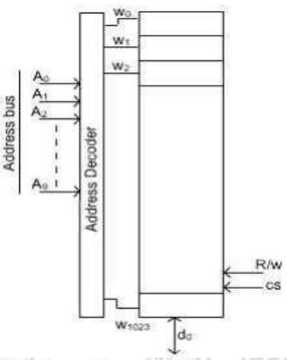
Organization of memory word as row

Slide 7
References
Reference Books:
J.P. Hayes, “Computer Architecture and Organization”, Third Edition.
Mano, M., “Computer System Architecture”, Third Edition, Prentice Hall.
Stallings, W., “Computer Organization and Architecture”, Eighth Edition, Pearson Education.
Text Books:
Carpinelli J.D,” Computer systems organization &Architecture”, Fourth Edition, Addison Wesley.
Patterson and Hennessy, “Computer Architecture”, Fifth Edition Morgaon Kauffman.

Slide 8
Other References
http://www.sgrrits.org/pdf/e-content/IT/Internal-organization-of-Memory-chips.pdf
https://www.ics.p.lodz.pl/~dpuchala/CompArch/Lecture_6.pdf
Video References
https://www.youtube.com/watch?v=LetdmZ3V-dk
https://www.youtube.com/watch?v=3x9OMMwU7dQ

